Slide 1
NHS Equality Delivery System 22
Leeds Maternity Services

Slide 2
Aims
Brief overview of the what the NHS Equality Delivery System 22 is
Summary of latest local maternity service findings
Self-assessment based on ‘Domain 1: Commissioned or provided services’ for three key workstream areas within Leeds maternity service:
Health Equity Midwifery Team
Haamla Specialist Midwifery Team
Preterm Birth Specialist Midwifery Team

Slide 3
What is the EDS?
A performance framework that helps NHS organisations improve services they provide or commission for their local communities and helps create better working environments, free of discrimination, for those who work in the NHS.
The EDS consists of three domains:
Domain 1: Commissioned or provided services
Domain 2: Workforce health and wellbeing
Domain 3: Inclusive leadership
This presentation will focus on Domain 1 and the self-evaluation of three maternity workstreams at LTHT:
Health Equity Team
Haamla Specialist Midwifery Team
Preterm Birth Specialist Midwifery Team

Slide 4
Domain 1: Commissioned or provided services
Each of the identified three midwifery services will be presented with collated evidence shared which provides insight into the following 4 outcomes:
Outcome 1A | Service users have required levels of access to the service
Outcome 1B | Individual service user’s health needs are met
Outcome 1C | When service users use the service, they are free from harm
Outcome 1D | Service users report positive experiences of the service

Slide 5
Local Maternity Service Survey Findings
NHS Maternity Services Survey 2023
Compared with other English NHS Trusts LTHT scored
Better than expected for 9 questions
Somewhat better than expected for 5 questions; and
Somewhat worse than expected for 1 question
A link to the full survey can be found here: Leeds Teaching Hospitals NHS Trust.pptx (live.com)

Slide 6
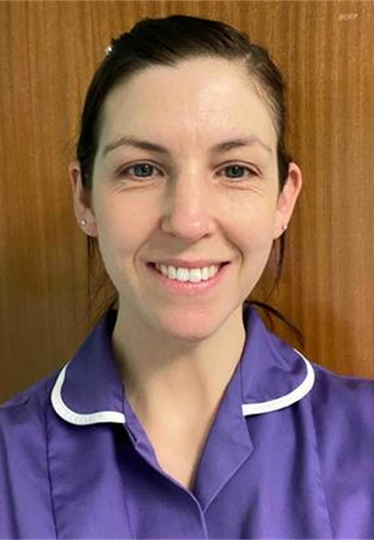

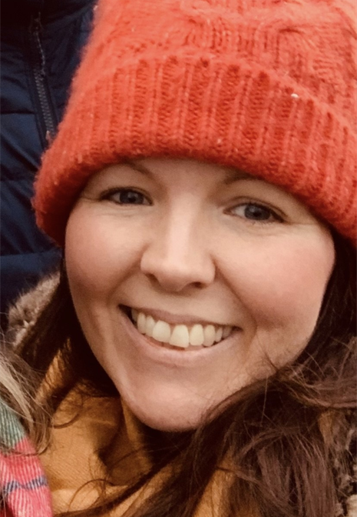
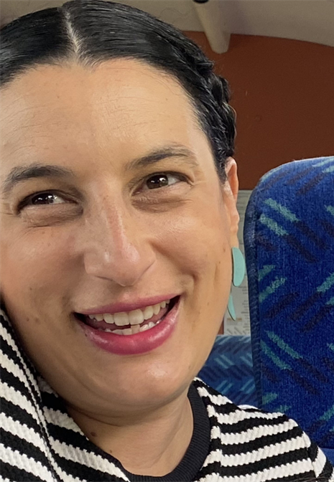
Health Equity Team
Consists of x1 WTE Consultant Midwife, x2 WTE Specialist Health Equity Midwives, x1 Consultant Obstetrician and Gynaecologist who has allocated hours to work alongside the team on workstream development.
Use data, research evidence and service-user feedback to understand our local maternity population demographics, outcomes and feedback and work collaboratively across the Leeds place and region to ensure that equity in maternity services is prioritised.
Key workstreams include:
Reducing Smoking in pregnancy
Maternal Healthy Weight
GDM and type 2 diabetes prevention
Reducing disparities in stillbirth
Improving service access for reduced fetal movements
Engaging and collaborating with our maternity communities
Staff education and awareness around racial biases, health equity and unconscious bias
Notes:
The Health Equity team comprises of:
Jenny Roddy
Role is a mixture of leadership, management, education, audit, research and clinical expertise focussed on improving population health and equity in maternity services.
Leads on maternal healthy weight and tobacco cessation workstreams within maternity
Cross-city working in relation to smoking cessation, gestational diabetes and type 2 diabetes prevention and improving equity in maternity services
Member of the QI crew, supporting colleagues with quality improvement within the CSU
Dr Tejinder Kaur-Desai
MDT working with wider team
Clinical expertise
Aligning the workstreams into frontline practice
Nada Abdul-Majid
Patient and public engagement and leading on health equity workstreams within Leeds maternity
Anna Cockerham
Leads on the enhanced midwifery pathway for women with a BMI >40 at booking- provides holistic education, support and continuity throughout pregnancy and into the postnatal period via the Athena pathway

Slide 7

Five Year Health Equity Strategy
The Vision
“Every individual should have a fair and just opportunity to attain their highest level of health. We aspire towards a future where unfair and avoidable or remediable differences in health among population groups defined socially, economically, demographically or geographically are absent”.
Notes:
The team have recently published a Five Year Health Equity Strategy which lays out the vision for the maternity service, taking account of local, regional and national priorities related to health equity in maternity services. Our vision is that: “Every individual should have a fair and just opportunity to attain their highest level of health. We aspire towards a future where unfair and avoidable or remediable differences in health among population groups defined socially, economically, demographically or geographically are absent”.
We will do this in a number of ways by working collaboratively within the CSU, our hospitals, city-wide and regionally to embed a health inequalities lens within all workstreams within the service, and ensure that maternity care is high quality, accessible and appropriately responsive to those using our services, to allow people to optimise their health and wellbeing. Key areas of focus within this are:
Quality Improvement
Population health work- particularly around tobacco cessation, maternal healthy weight and gestational diabetes
Collaborative cross-city and regional working
Listening to the people who use our services and co-production
Education
Having a communication strategy

Slide 8
Outcome 1A: Service users have required levels of access to the service
Workstreams are developed through co-production, service-user feedback, examining our data, existing literature evidence-base and guided by local, regional and national insight
On basis of proportionate universalism- services are designed and delivered at a scale and intensity proportionate to the degree of need
Example workstreams include:
Reducing smoking in pregnancy
The Athena Enhanced Midwifery pathway for women with a booking BMI ≥40
Maternal Journal
Local audits undertaken to understand if disparities exist with stillbirth rates and presentation to our service with reduced fetal movements, then focus groups with key cohorts to explore those findings and learn how to make improvements in the service for those groups having poorer outcomes
City-wide working group to design, implement and pilot a secondary care referral mechanism into the local NDPP to improve access and ultimately T2DM prevention.
Notes:
In relation to Outcome 1A: Service users have required levels of access to the service:
Workstreams within our maternity service are developed through co-production, service-user feedback, examining our data, existing literature evidence-base and guided by local, regional and national insight
We work on the basis of proportionate universalism- whereby services are designed and delivered at a scale and intensity proportionate to the level of presenting need
Examples of where the health equity team have demonstrated this particularly are:
Workstreams including:
Reducing smoking in pregnancy
Approaches have been taken to target areas of high deprivation and high smoking prevalence with face-to-face specialist stop smoking clinics close to the women’s homes to try to improve access to tobacco cessation support. These are in areas where smoking rates are high and engagement with tobacco cessation is low. A national voucher incentive scheme will launch in Q3 of 2024 to help improve engagement with tobacco cessation for pregnant women.
The Athena Enhanced Midwifery pathway for women with a booking BMI ≥40
Specialist midwife provides an enhanced midwifery pathway for women with a BMI >40 at booking which includes collaborative MDT working and personalised care pathway planning, holistic education, support and continuity throughout pregnancy and into the postnatal period via the Athena pathway. This is a targeted workstream as women with BMI >40 have more chance of complications during pregnancy and birth- particularly in relation to increased rates of hypertension, diabetes, postpartum haemorrhage and operative delivery. A service evaluation of a previous year long pilot called ‘Start Well’ showed that women wanted this type of service.
Maternal Journal
Funding acquired to pilot a maternal journal course targeting Asian pregnant women in Chapeltown- we identified our target audience through exploring local data and national research focusing on who has the poorest perinatal outcomes on a local and national scale. Benefits of the programme include: reduced social isolation, improved peer support, improved community connection and cohesion and linking with key services and education and support from a specialist midwife throughout.
Local audits undertaken to understand if disparities exist with stillbirth rates and presentation to our service with reduced fetal movements, then focus groups with key cohorts to explore those findings and learn how to make improvements in the service for those groups less likely to access secondary care services with RFM in a timely manner.
City-wide working group to design, implement and pilot a secondary care referral mechanism into the local NDPP to improve access and ultimately T2DM prevention
Local audit has shown that referral to and uptake of the National diabetes prevention programme post birth for women that have had gestational diabetes is very low. Engagement in this preventative programme is really important because research shows that up to 50% of women with a history of GDM go on to develop T2DM within 5-10 years of giving birth. We have worked collaboratively and with NHS E to pilot a secondary care referral mechanism into NDPP from maternity services- to address some of the traditional barriers that women had in accessing this service.

Slide 9
Outcome 1B: Individual service user’s health needs are met
Not a one-size fits all approach to meeting service user needs
Recognise the conditions in which we are born, grow, live, work, earn, learn and age all have an impact on our access and engagement with healthcare and ultimately our long term health outcomes and life expectancy
The service has developed a health inequalities dashboard to ensure we can use our data to understand our population demographics, characteristics and outcomes
We can then use this data, coupled with patient feedback and engagement to target those where disparities in health outcomes exist
One example here is the creation of the Bump and Baby Fit Programme to improve access to free physical activity provision to those with the biggest barriers to keeping active (targeted to those in socioeconomically deprived areas where access to green spaces is limited, and to populations at most risk of obesity and type 2 diabetes).

Slide 10
Outcome 1C: When service users use the service, they are free from harm
Quality improvement plays a huge part in all of the workstreams we develop and pilot.
Harm is reduced by co-designing services from the off-set and working collaboratively with key partners across the city
Auditing and evaluating is a key part of all workstreams to ensure a continual process of learning, reviewing and adapting is in place to ensure workstreams align with patient needs.
One example:
Bump and Baby Fit is being fully evaluated by Leeds University as part of a research project so we can equitably measure its effect and service-user feedback.

Slide 11

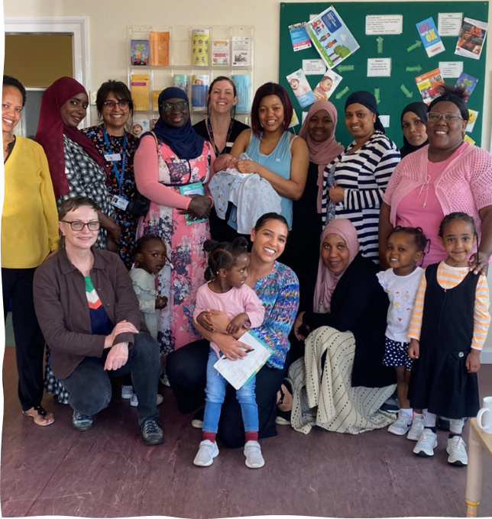
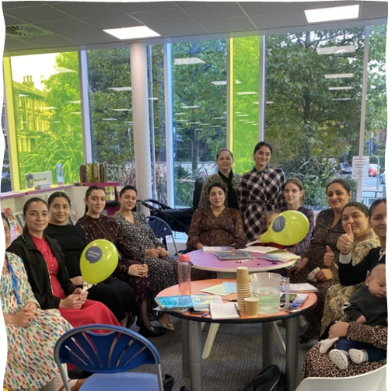
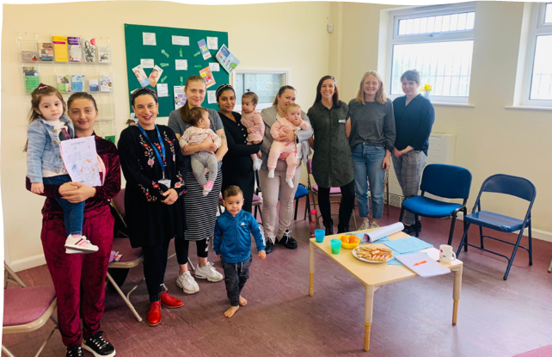
Outcome 1D: Service users report positive experiences of the service
Engaging with communities:
Allows learning from experience
Co-production- ensures services are designed with and by those who use them
Overcoming barriers and building trust
Sharing power
Ultimate goal = Safer, more inclusive and personalised care.
Notes:
Our Health Equity Strategy lends heavily to engaging with our communities to ensure that service-user voice is incorporated into service planning and delivery.
Engagement work is also often prompted by local data exploration – example- the reduced fetal movements audit and enquiry to understand if there were disparities in timely presentations for RFM- this was disseminated widely and accepted as an abstract at RCOG World Congress

Slide 12
Feedback from engagement activities:
Our Maternity Voices Film (created Jan 2023): https://www.youtube.com/watch?v=_1K_HIxma88
Feedback from focus groups with Black African and Romanian women:
“It was easy to get help or advice if pregnancy was more complicated”
Individuals whose first language was not English and required interpreters generally felt well informed of where to call for help if needed, as their MW’s had told them about the MAC number etc
“The Baby Buddy App was especially useful and informative throughout all of pregnancy”
When accessing maternity care at both SJUH and LGI women reported feeling “listened to, taken care of and informed along the way”
13 Romanian women spoke particularly high of the continuity model in Chapeltown. One women said "I felt so confident when my midwife was there (for the birth)."
Interpreter experiences positive on the whole, with face to face preferred but grateful for options of telephone and video interpreting options
Notes:
Feedback is continually being gathered from service users and efforts made to capture feedback from all pockets of our maternity population, particularly those more likely to be seldom-heard.
Maternity service and this team works closely with our MVP colleagues to help steer service-user voice feedback in key areas that can influence design and delivery of the service to maximally benefit patients
Work ongoing with language line and the LTHT PPI team to ensure that FFT feedback access is improved, work is underway to capture feedback in women’s own language which language line will then translate back to the service in English, to pilot using volunteers to support women to give feedback in ward areas for example

Slide 13
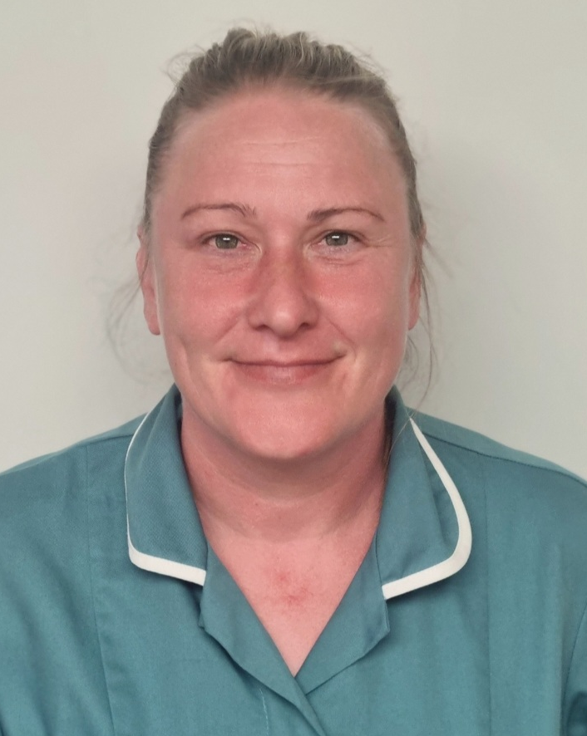
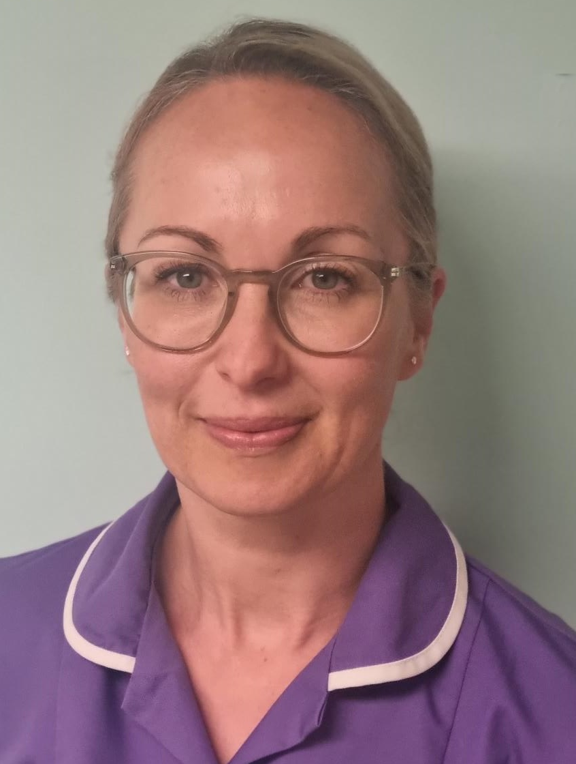
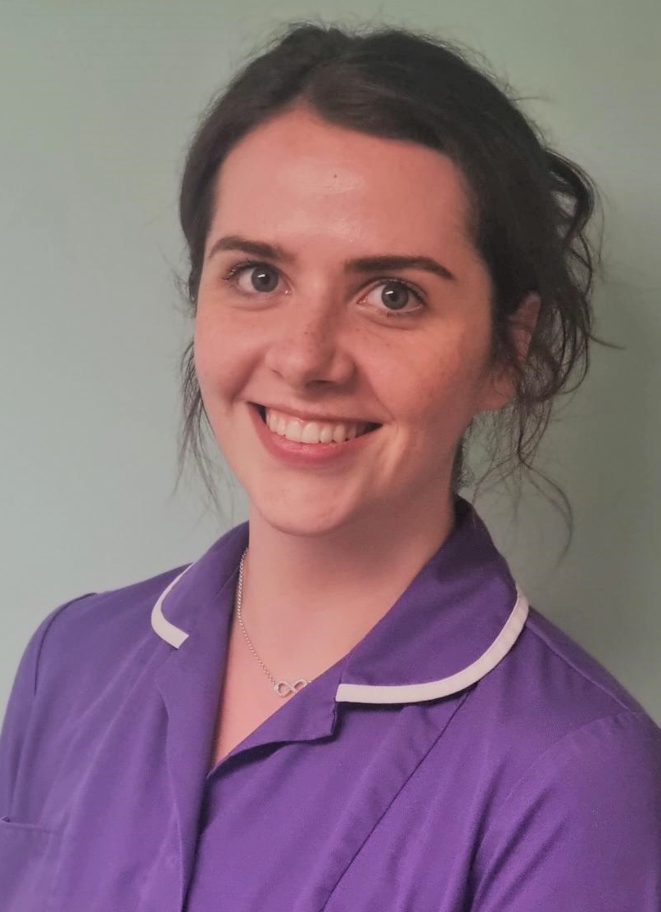
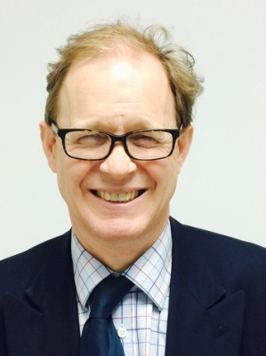
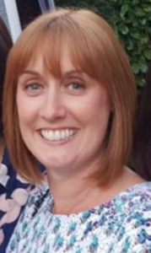
Preterm prevention and optimisation team
The preterm clinic in Leeds has been running for over 20 years.
The team is made up of two Consultant Obstetricians, two Preterm Specialist Midwives (1.8 WTE) and an MSW (0.5 WTE).
The team aims to optimise care, safety, experience and outcomes for those at risk of preterm birth and those who have delivered prematurely.
Key Workstreams
Preterm prevention antenatal clinic
Postnatal debriefs and planning for future pregnancies
Enhanced antenatal midwifery pathway for those highest risk of preterm birth
Postnatal care for those who have delivered prematurely
Quality improvement work
Staff education on all elements across the preterm perinatal pathway
Notes:
The Leeds Preterm Team is made up of two Consultant Obstetricians, two Preterm Specialist Midwives and one Maternity Support Worker.
The teams aim is to optimise care, safety, experience and outcomes for those at risk of preterm birth and those who have delivered prematurely.
Leeds has had a consultant-led preterm prevention clinic for over 20 years and is led by Mr Simpson and Dr Bonney.
There are two clinics a week, one at each side of the city and it sees women who are intermediate and high risk of preterm birth (as per the Saving Babies Lives version 3 risk assessment). The time and frequency of these appointments are personalised to each patient based on their individual need. Mr Simpson and Dr Bonney also provide postnatal debriefs to birthing people who have had late miscarriages or unexpected preterm births to help plan for future pregnancies. These birthing people will then often attend the preterm clinic in their subsequent pregnancy.
Kalliste (top photo in green) is the maternity support worker (MSW) within the preterm team and assists in providing continuity and support for women who are at high risk of preterm birth. Her role is integral in the implementation of national guidance pertaining to the care of those at risk of preterm birth.
In 2022, two Preterm Specialist Midwives, Gemma Miller and Lizzie Kilburn joined the team to provide holistic midwifery care to the women at highest risk of preterm birth. They offer an enhanced antenatal pathway, and provide postnatal care to those who have delivered prior to 34 weeks gestation, as well as working as part of the preterm MDT to provide staff education and quality improvement work.

Slide 14
Outcome 1A: Service users have required levels of access to the service
Antenatal care
Many of the birthing people who attend the preterm clinic have previously experienced late miscarriages, extreme preterm births and neonatal death between 16 and 28 weeks gestation
On the standard multiparous maternity pathway, this is the same period where there is a gap in midwifery care
These birthing people required specialist midwifery input to help support their complex emotions needs in subsequent pregnancies
20 weeks
25 weeks
31 weeks
16 weeks
28 weeks
34 weeks
36 weeks
38 weeks
Term
Notes:
In relation to outcome 1a: service users have required levels of access to the service
Many of the birthing people who attend the consultant led clinic had previously experienced late miscarriages, extreme preterm births and neonatal death between 16 and 28 weeks gestation. These women will often require treatment in the form on a cervical suture or progesterone to prevent this from occurring again. On the standard multiparous maternity pathway, this is the same period where there is a gap in midwifery care meaning that the women have no scheduled contact with a midwife at their most anxious time.
It was clear from listening to the service users attending the clinic that more midwifery support was needed over this period, and having continuity at each appointment meant that they didn’t have to re-tell their previous traumatic story. Since April 2022 the Preterm Specialist Midwives have offered this enhanced antenatal care pathway to anyone who requires a cervical suture or progesterone. This midwife-led clinic replaces the community midwife appointments and runs alongside the consultant clinic so that there is close communication between the obstetric and midwifery care. It facilitates additional and longer appointments allowing for timely emotional support when it is most needed.

Slide 15
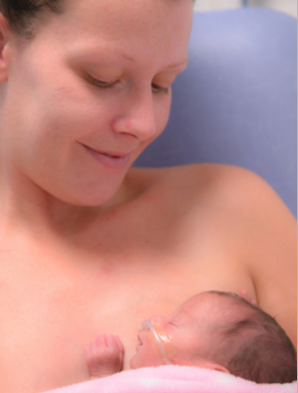
Outcome 1A: Service users have required levels of access to the service
Postnatal care
From speaking to families following a preterm birth, it was clear that whilst their baby is on the neonatal unit (NNU) the needs of the mother, both physical and emotional are often overlooked
Since June 2023 the Preterm Specialist Midwives have been offering outpatient postnatal care on the NNU to those who have delivered prior to 34 weeks
This promotes
Continuity in the postnatal period
Flexible and personalised care
Increases the amount of time that the parent(s) can spend with their baby, promoting family integrated care
Overview of the patient’s emotional needs and offer timely referral to mental health support if needed
Support with expressing/breastfeeding a preterm baby
Notes:
For families who have had a preterm birth, especially when that baby is born under 34 weeks and requires care on the neonatal unit, the needs of the mother can often be overlooked. On speaking to families who had experienced this, there were common themes as to why this was the case:
The service users needed to take time away from the neonatal unit and their baby to either go to the postnatal ward, or wait at home to see a community midwife to receive their postnatal care. They were often reluctant to do this, as they were very aware of how precious the time on the neonatal unit with their baby is.
The postnatal wards are very busy, and would often have to wait prior to being seen
They would often be seen by a different midwife each time, meaning that they had to repeat their story multiple times
Since June 2023 the Preterm Specialist Midwives have been offering outpatient postnatal care on the NNU to those who have delivered prior to 34 weeks gestation. Gemma and Lizzie aim to meet everyone who has delivered under 34 weeks either prior to there birth or soon after whilst they are still an inpatient. This provides an opportunity to discuss what to expect when having a baby on the neonatal unit and facilitates early discussions about the importance of early breast milk for preterm babies. Once the mother is discharged, they have their postnatal care on the neonatal unit at the cot-side with their baby.
This promotes:
Continuity in the postnatal period
Flexible and personalised care
Increases the amount of time that the parent(s) can spend with their baby, promoting family integrated care
Overview of the patient’s emotional needs and offer timely referral to mental health support if needed
Support with expressing/breastfeeding a preterm baby

Slide 16
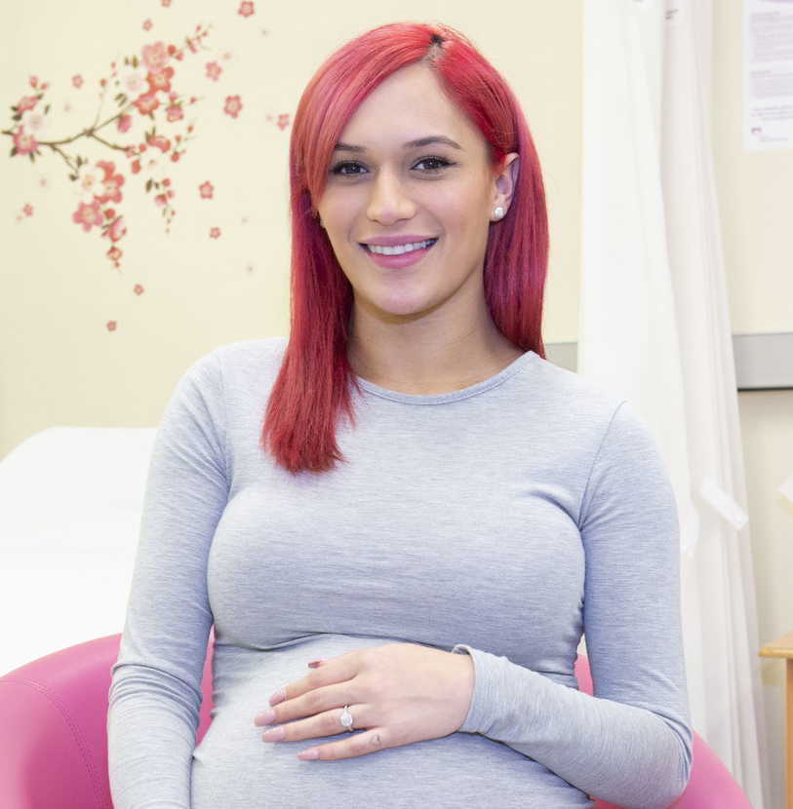
Outcome 1B: Individual service user’s health needs are met
Creating personalised care plans has been at the centre of the development of the preterm antenatal and postnatal pathways. Whilst there are frameworks for the pathways, these can be altered to suit to the need of that family
Antenatal examples
Appointment at the gestation of the previous birth
More frequent appointments if needed
Discussing symptoms of preterm labour
Tailoring antenatal education conversations to the
needs of the family
Direct phone numbers to the Preterm Midwives for non-urgent concerns and questions
Notes:
Creating personalised care plans has been at the centre of the development of the preterm antenatal and postnatal pathways.
Whilst there are frameworks for the pathways, these can be altered to suit to the need of that family. For example:
The preterm midwives always strive to see families at the gestation of their previous birth. This is such an important time to have contact with these birthing people as it is often where they are the most anxious.
More frequent appointments can also be facilitated during their pregnancy if that is what the family feels they need.
Specific discussions are had around the symptoms of preterm labour and the importance of contacting the hospital early
Tailoring antenatal education conversations to the needs of the family. For example, some service users prefer to defer conversations around feeding until later in the pregnancy, as they are often not emotionally ready to think about going home with a live baby until closer to their due-date, in view of their past experiences
Direct phone numbers to the Preterm Midwives for non-urgent concerns and questions
If families prefer to continue their antenatal care with their local community midwife, then that would be supported. These service users will still have the contact number of the Preterm midwives in case they need any specific advice

Slide 17

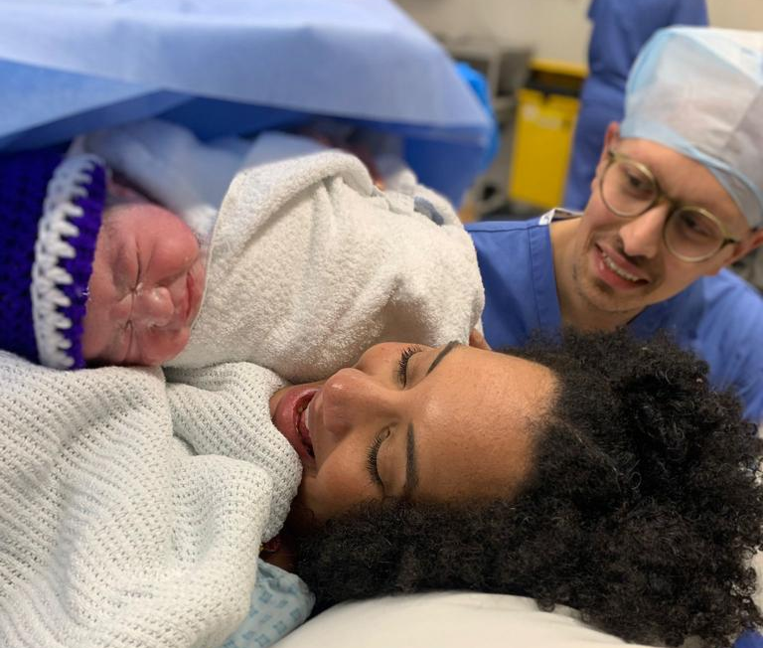
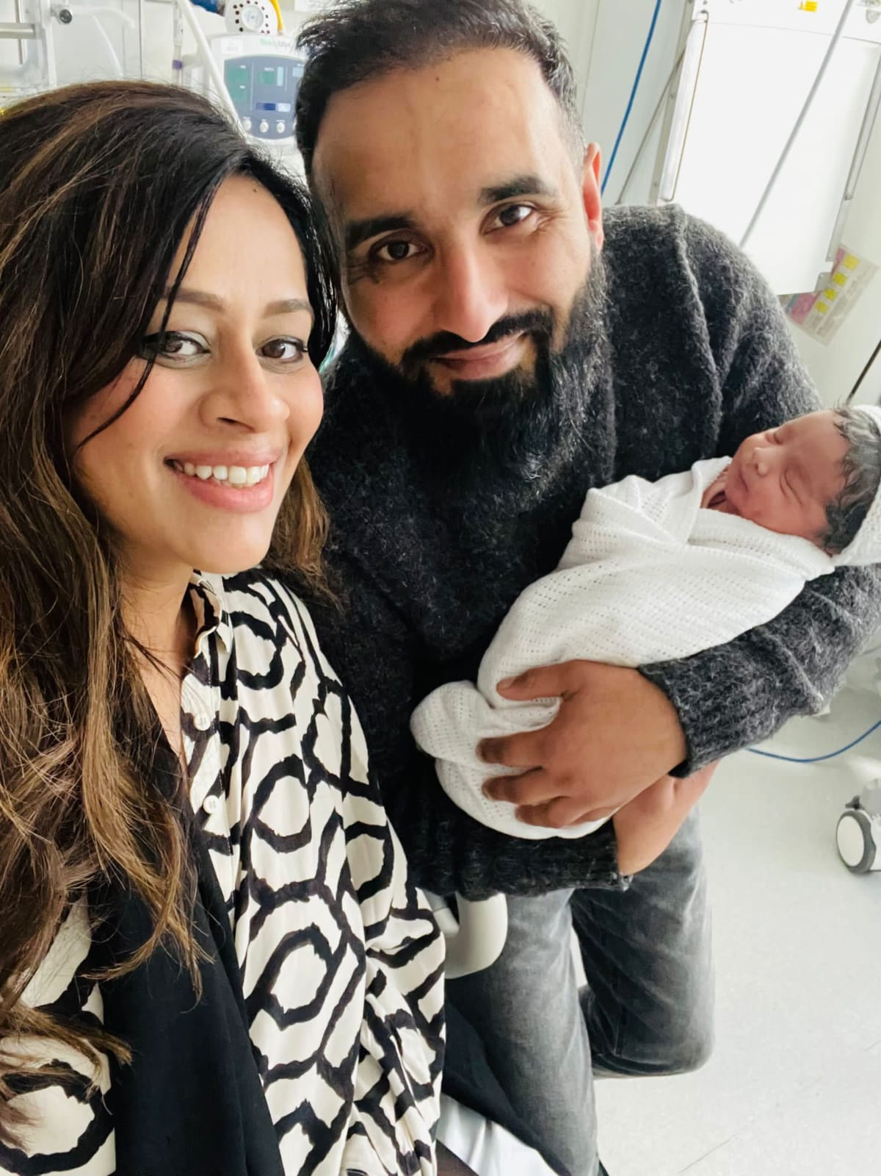
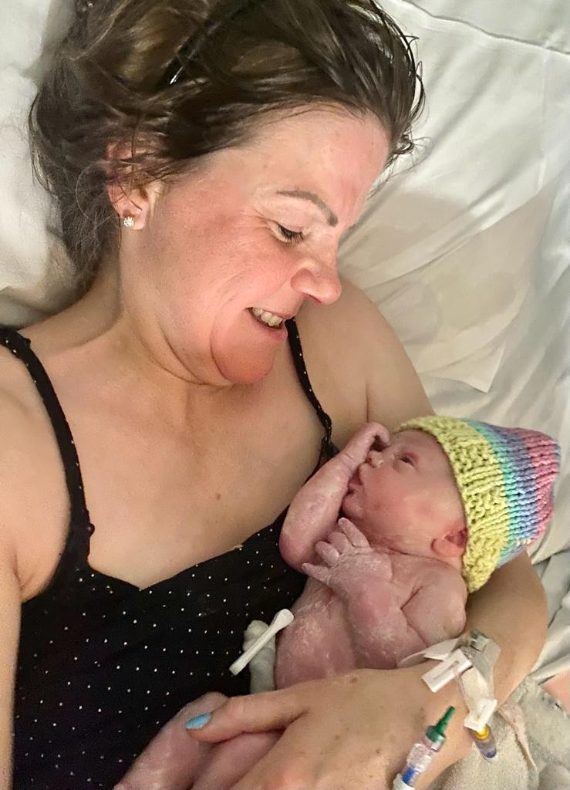
Outcome 1C: When service users use the service, they are free from harm
Of the service users that had antenatal care from the Preterm Specialist Midwives:
72% had term births
83% had births over 34 weeks gestation
94% of families went home with a live baby
In this same group of birthing people
12% had previously had a term birth
51% had experienced a late miscarriage or neonatal death
Of the service users who had previously had a baby, only 42% had previously taken a live baby home
Notes:
For outcome 1c- the outcomes from the preterm clinic and caseloading are very good.
Of the service users that received their antenatal care from the Preterm Specialist Midwives
72% had term births (after 37 weeks gestation)
83% had births over 34 weeks gestation
94% of families went home with a live baby
This is in contrast to these same group of birthing people’s previous experiences
Only 12% had previously had a term birth
51% had experienced a late miscarriage (16-22 weeks) or had a neonatal death
Of the service users who had previously had a baby, only 42% had taken a live baby home
(11% were on their first pregnancy when they were cared for by the team)
The photos on the right have been shared with consent, and are photos of the families who were cared for by the Preterm Midwives and Consultants in the pregnancy following a loss.

Slide 18
Outcome 1D: Service users report positive experiences of the service
Service user survey for women who have had antenatal care with the Preterm Midwives
Notes:
Electronic surveys are given to service users who receive either antenatal or postnatal care from the preterm midwives, both have very positive feedback about the care.
100% of service users said their antenatal care was either very personalised or personalised
100% of service users said they had enough face-to-face contact with their preterm midwife
100% of service users said their antenatal care was either very good or good

Slide 19
Quotes from service users about their antenatal care
“My preterm midwives should be the benchmark for others’.
“They made me feel safe and cared for”
“They really helped me to prepare for my next birth”
“They were understanding and compassionate of my past”
“They never made us feel like just another number on a patient list”
“The preterm midwives gave me extra support that was personalised to me and my unique situation”
“They made a difficult time a lot easier and I cannot thank them enough”
“My appointments never felt rushed and were so personal”
"I never had to re-tell my story”
Notes:
These are some quotes received from service users about their antenatal care from the preterm midwives

Slide 20
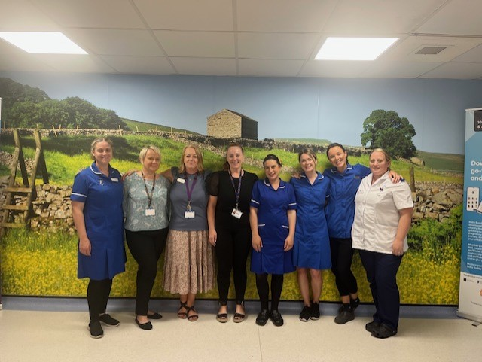

Haamla Specialist Midwifery Team
“Pregnant Woman” or “With Child”
Established
1992 support midwives 2010–
Local Health Needs Analysis identifying gaps in service provision.
Unique nationally recognised service provided by an innovative team.
Rationale
Improve maternal, fetal and neonatal outcomes / health & wellbeing.
Trauma and mental health support
Improve engagement /acess with healthcare & midwifery services.
Empower and Inform
Team Composition
1 wte Team Leader
2.9 wte Midwives
1.4 wte Bi-lingual Maternity Support Workers

Slide 21
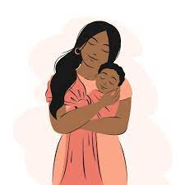
Outcome 1A: Service users have required levels of access to the service
Women are provided with antenatal and postnatal case loading care within their own homes to ensure easy access to services and better engagement with maternity services. All women are provided with an interpreter when required.
Referrals are made from community midwives, GP’s, External Agencies e.g. PAFRAS, Maternity Action, Ashiana, Salvation Army and self referrals.
Caseload Criteria Workstreams
Vulnerable BME Women Antenatal & PN FGM Clinic
Asylum Seeker One to one parentcraft in own homes
Isolated Refugee Bi-lingual group antenatal sessions
Gypsy Travellers Baby feeding group
Visa: Family/Spouse Reunion Social support – Housing, provision of
Domestic Violence baby equipment and safe sleeping
Homeless Women moses baskets.
Trafficked Community engagement events
New Migrants National training & development
National & local guideline development
Audit and evaluation

Slide 22
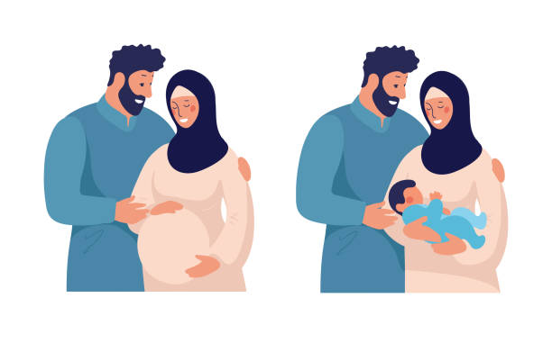
Outcome 1B: Individual service user’s health needs are met
Care provided by specialist midwives who have extra training in safeguarding, FGM, trafficking, trauma informed care.
Personalised care provided individualised to each family's personal circumstances
Trauma Informed – work closely with PNMH services and Maternal Mental Health Service.
Care provided in women’s own homes – family orientated care which helps to break down barriers and build trusting relationships
Good working relationships with third sector organizations to provide further or ongoing support.

Slide 23

Outcome 1C: When service users use the service, they are free from harm
Care is provided in safe venue of choice this could be in woman’s own home, hospital setting or other venue.
We adapt our care to individual situations for example women suffering from domestic violence or women who have been trafficked.
The experience of the staff allows them to be more acutely aware of when a safe space if required for a woman to disclose any concerns.
Measurement of outcomes to improve service provision and patient experience.
Development of QR feedback to collate team specific feedback
Examples
Providing care to trafficked women in safe houses
Providing midwifery services in Afghan refugee hotels within Leeds

Slide 24
Haamla Outcomes / Data Informing Safe Care
Outcome | Total 2023 up to 14/12/23 | % 2023 | Total 2022 | % 2022 | Total 2021 | % 2021 | Total 2020 | % 2020
LTHT Births | 8123 |  | 8701 |  | 8733 |  |  | 8686
Haamla Births | 189 | 2.3% | 209 | 2.4% | 124 | 1.4% | 117 | 1.3%
Induced Births | 79 | 41.8% | 79 | 37.8% | 51 | 41.1% | 41 | 35%
Live Births | 189 | 100% | 209 | 100% | 124 | 100% | 117 | 100%
Term Births | 177 | 93.7% | 205 | 98.1% | 117 | 94.4% | 112 | 95.7%
SVD | 96 | 50.8% | 104 | 49.8% | 74 | 59.7% | 60 | 51.3%
Ventouse | 4 | 2.1% | 7 | 3.3% | 1 | 0.8% | 7 | 6%
Forceps | 13 | 6.9% | 17 | 8.1% | 13 | 10.5% | 13 | 11.1%
Elective CS | 18 | 9.5% | 26 | 12.4% | 18 | 14.5% | 11 | 9.4%
Emergency CS | 58 | 30.7% | 55 | 26.3% | 18 | 14.5% | 26 | 22.2%
3rd & 4th Degree Tear | 5 | 2.6% | 2 | 1% | 4 | 3.2% | 7 | 6%
EBL >1500mls | 5 | 2.6% | 16 | 7.7% | 6 | 4.8% | 6 | 5.1%
BF at 1st Feed | 132 | 69.8% | 156 | 74.6% | 83 | 66.9% | 84 | 71.8%

Slide 25

Outcome 1D: Service users report positive experiences of the service
“The thing which I love at Haamla is our diversity. We are mixing across different countries, exchanging our culture, traditions and making new friends”
“We are so incredibly grateful to have met you, thank you for your excellent care during all my pregnancies”
“Haamla groups are special sessions for migrant women. I’d like to recommend other women to join the group and learn new knowledge”
“Words can’t express how grateful I and my family are with the help and support you have provided, thank you so much you really inspire me”
“You create a safe space are so helpful, kind, nice; you’ve been amazing we feel so blessed”

